Slide 1
Apprenticeships
In Schools
Primary Leadership Updates
Autumn
Lauren Reader,
Apprenticeships & Talent Development Partner at Norfolk County Council
NCCApprenticeships@Norfolk.gov.uk

Slide 2
Utilising NCC Schools’ Apprenticeship Levy
NCC Schools accrue on average £38,000 in each month’s pot to be used towards apprenticeships (total paid in by schools to date is £1.1 Million)
Total amount spent to date by schools since September 2017 is £47,783.32 through 39 school apprentices (averaging a £1,990.97 spend per month). Total committed is £152,389.00
The apprenticeships used so far by schools create an average monthly apprenticeship cost of £99.75 per person. Typically these have been
Teaching Assistant
Business Admin
PE
IT
Caretaking
36 LA schools currently engaged
Schools are forecast to lose money imminently (up to £60k) and then
every month
Each Months’ Pot
Lasts For
24 Months
Then Expires
Notes:
(159 in total so 123 who aren’t?)

Slide 3
How to use apprenticeships for impact …
What it would take to spend your share of the levy?
App Title | Total | Monthly | Final | Number | Total PM
Teaching Assistant | £5,000 | £222.22 | £1,000 | 30 | £6,666.60
STL with PE | £3,000 | £200.00 | £600 | 20 | £4,000.00
Teacher | £9,000 | £600.00 | £1,800 | 5 | £3,000.00
Senior Leaders Level 7 (MBA or MEd) | £18,000 | £600.00 | £3,600 | 20 | £12,000.00
Caretaker | £9,000 | £600.00 | £1,800 | 5 | £3,000.00
Project Management | £6,000 | £266.67 | £1,200 | 5 | £1,333.33
Leadership Matters | £4,500 | £300.00 | £900 | 5 | £1,500.00
Education Management Prog. For Teachers | £7,000 | £233.33 | £1,400 | 5 | £1,166.67
Certificate in Higher Education | £6,000 | £266.67 | £1,200 | 5 | £1,333.33
Business Administrator | £5,000 | £222.22 | £1,200 | 10 | £2,222.22
School Business Manager | £6,000 | £228.57 | £1,200 | 5 | £1,142.86

Slide 4
What is CPD and Recruitment within apprenticeships
Ways to use the Levy
CPD and Recruitment
Demonstrating your commitment to staff members by investing your funds into their training and future could provide a welcome boost to morale and foster a sense of loyalty.
This can also remove the element of risk that always exists when bringing in new staff, as well as saving the money associated with recruiting someone new.
CPD
This is the way to go if you have identified gaps in your school’s workforce that need to be filled and which are at the level where they can be filled by an apprentice.
Apprentices can play a hugely important role in the way schools are run, whether they are in teaching assistant positions, or are support or back office staff.
Recruitment

Slide 5
What Schools are Saying …
Teaching Assistant Level 3 (18 months)
Has having an apprentice changed the school in any way? “Yes, it’s changed the range of ages in the school and has brought a fresh perspective to the possibility of in-school training. We would definitely have another.”
What would you say to a school who weren’t sure whether to take on an apprentice? “It’s certainly something worth considering and is an opportunity to re-evaluate learning and CPD in schools.”
Teacher Apprentice Level 6 (12 months)
How have you found your experience of recruiting a Teacher Apprentice?
“It has been a very exciting and rewarding experience for us as a school. [Our apprentice] is an outstanding practitioner and has fitted in very well to our school.
Having some flexibility over extra staffing has helped enormously and enabled us to offer enrichment activities such as signing. We certainly will be looking at going down this route again particularly with staff already employed at the school.”
Bev Theobald
Mulbarton Primary School
Little Plumstead VA. Primary School

Slide 6
What Schools are Saying …
Teaching Assistant Apprenticeship Level 3
A Teaching Assistant course would cost you
~ £876.60
A Teaching Assistant apprenticeship will cost you ~ £0 . If you are a LA school, the levy will pay the full cost (£5000)
Other schools can use their levy to pay for it or pay just 5% of the apprenticeship cost
= £250
Teacher Apprenticeship Level 6
A Teacher apprentice would cost the school
£0 for training if you use the levy (apprenticeship cost is £9000)
The course fee on other routes is £9000
Schools on the Apprenticeship route get a grant of £4500 towards costs (can be used towards salary)
There is further support during NQT year while they are undertaking the EPA
Benefit in the level of unsupervised teaching
the apprentices can undertake.

Slide 7
What Other Schools are Doing …
Drake Primary School and Nursery in Thetford
Apprentice Early Years Educator
- Children's and Young People's Workforce: Early Years Educator L3 (24 Months)
Fully Paid by the Levy
Apprentice Office Staff/Reception
- Business Administrator L3 (18 months)
Fully Paid by the Levy
Coastal Federation
Bacton Primary School, Mundesley Infant School and Mundesley Junior School
The Federation Business Manager is about to start an Apprenticeship as CPD
- Accountancy / Taxation Professional Level
(36 months)
Becomes Qualified Accountant

Slide 8
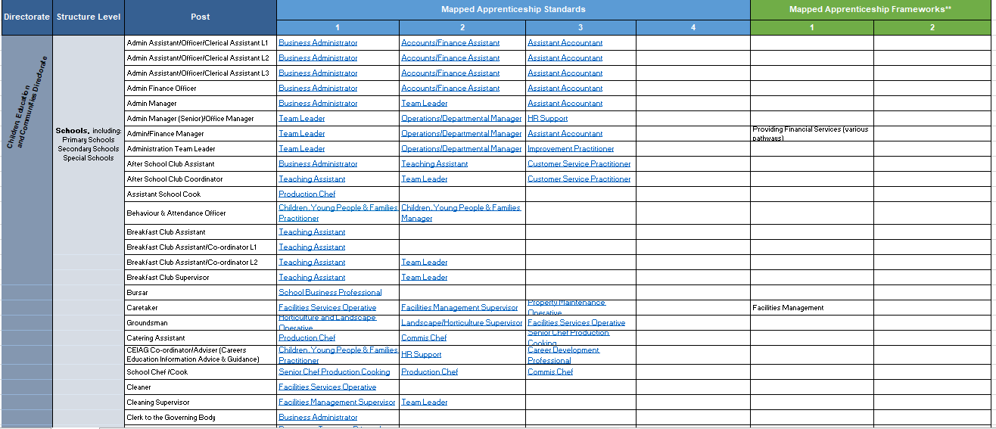
Next Steps and Future Developments
Example: Mapping Apprenticeships to Roles
Notes:
Again a mapped user friendly excel sheet with links.

Slide 9
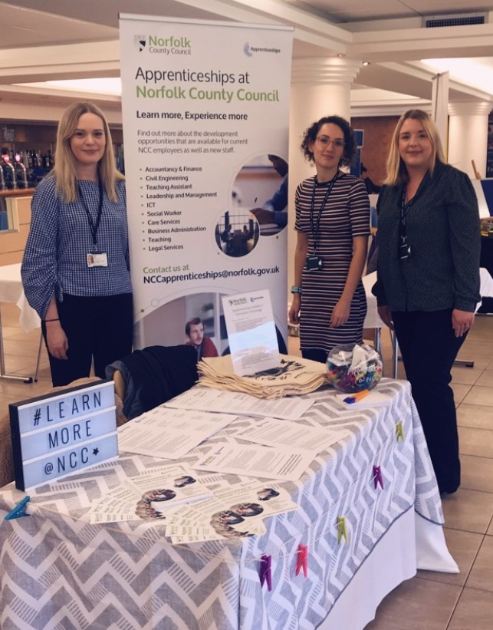
Where and How to get Support?
NCC Apprenticeships Team – Lauren, Amy, Emma and Molly
Email: NCCApprenticeships@Norfolk.gov.uk
Tel: (01603) 573569
HR InfoSpace – Educator Solutions
National College of Education for Leadership and Management in Schools and links to other apprenticeships
Educate Norfolk – The App and will host blogs and videos
DfE for finding a Provider and older but still live Frameworks,
Education and Skills Funding Agency for policy and guidance and
Institute for Apprenticeships and Technical Education for apprenticeship standards
Get In Touch!!

Slide 11
Strategic use of Apprenticeship Levy
IN THE SCHOOL
OUTSIDE THE SCHOOL
Agree to share levy within Supply Chain, such as:
Utilise the Levy on Higher Level apprenticeships at Level 7 such as an MBA or MEd
Develop your current and aspiring Middle Leaders with Education Management Programme for Teachers
Academies and MATs
Nurseries – training nursery staff
Non- levy paying VA, Foundation and Special schools
Offer CPD for non-teaching staff, such as Project Management, School Business Manager, ACCA/CIMA L7 qualifications, AAT, Team Leading, Caretaker/Facilities Management…
…OR even a Certificate in Higher Education in working with Children Young People and Families
Support Local SMEs to fund apprenticeship training – encouraging vacancies and opportunities for your pupils
Co-fund shared interest roles and train them with an apprenticeship (e.g. additional parenting support roles or Careers Advice etc.)
Create a wider talent pipeline of staff by recruiting using the Teacher, Teaching Assistant or Business Administrator (incl Reception) Apprenticeship Standards

Slide 12
Background
Since April 2017, schools across England have paid in circa £250M to the Levy.
Local Authority schools are generally underspending on their apprenticeship Levy.
In April 2019, the government began to reclaim unused funds.
There is no guarantee any of our unspent funds will return to Norfolk.
There is more that we can do to spend these funds and keep levy in the Norfolk Education system.
Each Months’ Pot
Lasts For
24 Months
Then Expires
Notes:
Local authorities will typically be responsible for paying the levy in community schools they maintain, where the local authority employs the staff and pays national insurance contributions (NIcs)
Where the local authority is the employer, schools will have access to funding for apprenticeship training, via the local authority’s digital apprenticeship service account.

Slide 13
Overview
Apprenticeships:
Updates
Background and Apprenticeships
Possibilities
Future and Next Steps
Where and How to get Support
Apprenticeships for
All Ages and All Levels… !!!
Email: NCCApprenticeships@Norfolk.gov.uk
Notes:
“Developmental Vocational Training that Assesses Competency”
An apprenticeship is a respected method of work-based learning that reflects the 70:20:10 model.
Requires 20% time learning (can be creative – not necessarily all off the job).

Slide 14
How Does the Levy Effect Schools?
Community and VC schools pay into the Local Authority levy
Where the local authority is the employer, schools will have access to funding for apprenticeship training via the local authority’s digital account and access the whole pot.
Academies, Foundation and VA schools will only be subject to levy if their pay bill is over £3M
Where this is the case the school, academy or MAT will have access to their own digital account to make payments.
For schools and academies who do not qualify to pay levy (pay bill over £3m) you can still benefit through the governments scheme to pay 95% of the apprenticeship training and just pay 5%.
The NCC Apprenticeships Team can:
The NCC Apprenticeships Team will:
Come out to the school if you would like
Discuss your requirements and help map apprenticeships to roles within the school
Facilitate access to levy funding and make payments on your behalf
159
Visit the school if you need support
Work with Ed Sol to discuss your requirements and help map apprenticeships to roles/ careers within the school
Help find a training provider and contract with them
Advise on appropriate job descriptions and salary
Offer guidance on what 20% off the job could look like for you
Share with you all guidance materials and best practice
Help you to access your levy account
Suggest and recommend on training providers we work with
Share details on open cohorts running and invite you to join
Show templates on job descriptions and salary
Offer guidance on what 20% off the job could look like for you
Share with you all guidance materials and best practice

Slide 15
Ways to use Apprenticeships
Think … CPD and Recruitment
Teaching Assistant
PE Sports
Finance/ Accounts
Catering
Childcare/ Early Years
IT/Digital
Lab Technician
Business Admin
Leadership & Mgmt.
Librarian
Facilities Services
Teacher
Notes:
You’ll see some examples on the table about scenarios for apprenticeships. We heard before from Mulbarton on the Teacher apprenticeship, but you could also consider Finance apprenticeships for support staff, or once you’ve identified your desired outcomes for PE and Sports Premium, considering whether an apprentice in Supporting Teaching and Learning with PE level 3 to train them could work. Or your own personal development or that of your leadership team with a level 7 leadership apprenticeship as an MBA or MEd in Educational Leadership …

Slide 16
ROLES
APPRENTICESHIPS
Children, Education and Communities Directorate
Schools
Children, Education and Communities Directorate
Schools
Notes
Standards marked * are still in development
All frameworks are subject to permanent withdrawal – important to understand when planning delivery for the future
Mapping is based on top level job role alignments to apprenticeships - review of job description vs. apprenticeship detail is required
Listings include both entry and progression routes for job roles where appropriate
Admin Assistant/Officer/Clerical Assistant L1/2/3
Admin Manager
Admin Manager (Senior)/ Office Manager
Admin Team Leader
Out of School/After School/Breakfast Club Assistant/Officer/Coordinator L1/2
Out of/After School/Breakfast Club Supervisor/Manager
Assistant School Cook Behaviour & Attendance Officer
Bursar
Caretaker/Groundsman Catering Assistant
CEIAG Coordinator/Adviser
School Chef /Cook
Cleaner
Cleaning Supervisor
Clerk to the Governing Body
Driver
Education Technician*
Examination Officer
Facilities & Premises Manager
Finance Assistant (Senior)
Finance Assistant
Finance Clerk
Finance Manager
Finance Officer (Senior)
General Kitchen Assistant
Health and Safety Officer
ICT Technician
Inclusion Manager
IT Manager
Language Support
Librarian
Marketing /Comms Manager
Midday Care Assistant
MSA Supervisor
MSA Special Needs
MSA (Senior)
Pastoral House Manager
Deputy SENCO
PE Coach/Specialist
Personal Assistant (to the Headteacher)
Senior HR Administrator
Playworker
Receptionist
School Business Manager
School Support Assistant
School Working Supervisor
Service Families Liaison Officer
SIMS Assessment/Data Manager
Site Manager L1/2/3
Sixth Form Support/Attendance Officer
Sports Coach/Teaching Assistant
Support Manager
Support Worker
Teacher
Teaching Assistant Behav Services – L3/4
Teaching Assistant L1/2/3/4
Senior Technician (TTO) Technician Manager
Mapped Standards:
Accounts/Finance Assistant
Advanced Coach (Sport and Physical Activity)*
Assistant Accountant
Business Administrator
Career Development Professional
Chartered Manager
Children and Young People's Family Practitioner
Children, Young People & Family Manager
Commis Chef
Community Safety Officer
Customer Service Practitioner
Customer Service Specialist
Data Analyst
Data Technician*
Digital Marketer (Degree)
Early Years Educator
Early Years Practitioner*
Early Years Lead Practitioner*
Educational Leadership*
Facilities Manager
Facilities Management Supervisor
Facilities Services Operative
Health Play Specialist*
Horticulture and Landscape Operative
HR Support
Improvement Practitioner
Improvement Leader
Information Manager*
Infrastructure Technician
IT Technician
Laboratory Technician
Landscape/Horticulture Supervisor
Library Information & Archive Specialist Assistant
Marketing Assistant
Marketing Executive
Marketing Manager
Operations/Departmental Manager
Mapped Standards (Cont.):
Passenger Transport Driver
Payroll Adviser
Payroll Assistant Manager*
PE, PA and Youth Sport Specialist*
Play Worker*
Production Chef
Professional accounting taxation Technician
Property/Maintenance Technician
School Business Professional
Senior Chef Production Cooking
Speech and Language Therapist
Teacher
Teaching Assistant
Team Leader
Mapped Frameworks:
Facilities Management
IT, Software, Web and Telecoms Professionals
Libraries, Archives, Records and Information Management Services
Libraries, Archives, Records and Information Management Services
Providing Financial Services (various pathways)
Notes:
Don’t expect you to read this here on the screen. This moves us on to looking forwards, how can we work together, what do you need from us, what are your skills development needs or hard to fill, hard to retain roles as well as support that is available to you and we can provide.
Whilst we work on electronic central locations to hold these resources that are most accessible to you, please do get in touch. In addition, materials from today will be circulated.

Slide 17
Next Steps and Future Developments
Set up Cohorts based on your key needs and requirements. Advertise them as open programmes with start dates – allowing you to enrol your potential apprentices.
Collaborate as Education Sector and Share Levy?
We Could …
Create Careers Mapping and Pathways document

Slide 18
City College Norwich announced as a
Centre for Excellence in SEND
The Education and Training Foundation (ETF) has announced three Centres for Excellence in SEND in Further Education (FE) and Training in England as part of a DfE funded national programme.
The Centres will each concentrate on one of three key practical themes for the programme:
City College Norwich will focus on community – ensuring learners with SEND are participating in their local communities, including creating pathways to employment.
Derby College will focus on curriculum – ensuring the curriculum always has a clear purpose so that learners with SEND have potential to achieve their aspirations.
Weston College will focus on people – ensuring organisations create inclusive cultures, motivating staff to engage in continued professional development with an emphasis on supporting learners with mental, social and emotional needs.
The three distinct Centres will provide expert support for leaders, managers and practitioners in FE and Training who wish to put learners with SEND at the centre of their organisation, resulting in learners achieving the outcomes they aspire to.
Each Centre will host a SEND Strategic Leadership Hub to provide leadership support to at least 15 leaders from a diverse range of providers across England’s Further Education and Training sector. This will support 120 managers and/or practitioners within the communities of practice
Notes:
Looking at supportEd Rose – CCN
“we can definitely do something in that value added space. It would be incredibly useful to get a schools understanding of what they need though – is there anyway to get a meeting with some of them to discuss?”

Slide 19
Creating a Talent Plan
Three elements to the plan:
Recruitment plan – who do you need to find
Development plan – who do you need to train
Succession plan – who is the next person in each key role in the organisation

Slide 20
Appendix A - Apprenticeships For Schools
Art Therapist (Degree)* - Level 7, Duration 24 Months
Assessor / Coach – Level 4, Duration 15 Months
Associate Project Manager – Level 4, Duration 18 Months
Business Administrator – Level 3, Duration 12-18 Months
Career Development Professional* – Level 6, Duration 24 Months
Chartered Manager – Level 6 (Degree), Duration 36-48 Months
Children, Young People and Families Practitioner within the Community – Level 4, 12-18 Months
Teacher – Level 6, 12 Months
Early Years Senior Practitioner* - Level 5, Duration unknown
Early Years Senior Practitioner* – Level 6, Duration unknown
Educational Leadership* – Level 7, Duration unknown
Operational Manager – Level 5, 24 Months
Payroll Administrator – Level 3, 18 Months
Professional Accounting/Tax Technician – Level 4, 18 months
School Business Professional – Level 4, 18 Months
Senior Leader (MA Ed.) – Level 7, 24 Months
Teaching Assistant – Level 3, 18 Months
Team Leader/supervisor – Level 3, 12 Months
Accounts / Finance Assistant* – Level 2, Duration unknown
Supporting Teaching and Learning in PE and School Sport-Level 3, 12 Months
Caretaker (Property Maintenance Operative) – Level 2, 12 Months
Chef (Commis) – Level 2, 12 Months
IT Solutions Technician – Level 3, 18 Months
Early Years Educator* – Level 3, 12-18 Months

