Slide 1
Making your pe and sport premium funding work for you
achieving school improvement priorities through physical activity.

Slide 2
Our role in pe & sport premium
Funded through DfE via Sport England we offer impartial advice by:
Understanding how the premium is used and the challenges schools face
Offering ongoing guidance to all schools
Supporting schools directly

Slide 3
Why should WE INCREASE THE physical activity LEVELS OF OUR PUPILS?

Slide 4
IT GIVES OUR PUPILS;
Short term impact = the best chance to learn
Long term impact = better LIFE outcomes

Slide 5
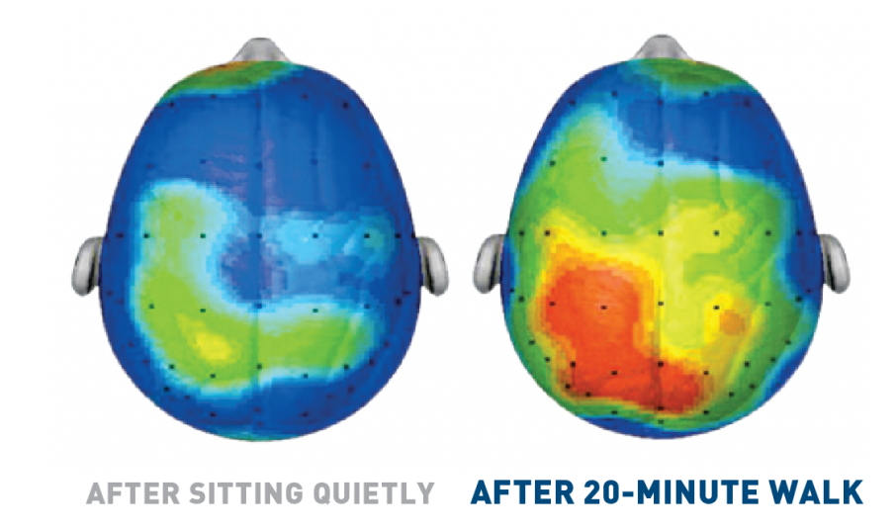
Our brains get active when we are…

Slide 6
The benefits of physical activity:
Academic attainment
Mental health & emotional wellbeing
Personal & social development
Physical health

Slide 7
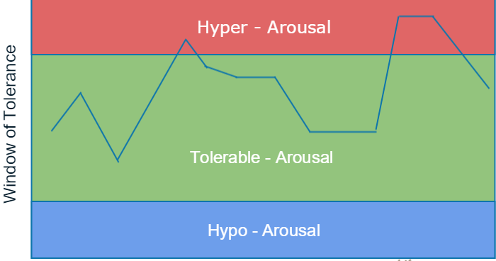
The benefits of physical activity:
Mental health and emotional wellbeing
Notes:
Building Resilience

Slide 8
How can I practically realise these benefits?
Put physical activity where it can benefit most:
At challenging times of the day
During priority subjects
Active breaks
For targeted young people
At a difficult time of year
Timetabling
Support young people into community activity

Slide 9
Physical activity is a tool that can help improve important outcomes
The PE and Sport Premium is ring-fenced funding to help you to do that
How is spend planned in your school to maximise this funding?

Slide 10
Pe and sport premium is a terrible name…ignore it

Slide 11
5 key indicators that schools should expect to see improvement across:
The engagement of all pupils in regular physical activity –
the Chief Medical Officer guidelines recommend that all children and young people aged 5 to 18 engage in at least 60 minutes of physical activity a day, of which 30 minutes should be in school
The profile of PE and sport is raised across the school as a tool for whole-school Improvement
Increased confidence, knowledge and skills of all staff in teaching PE and sport
Broader experience of a range of sports and activities offered to all pupils
Increased participation in competitive sport

Slide 12
Planning pe & sport premium spend:
Starting with your SIDP
Allow time for planning
Ensuring all staff understand and contribute to the PE & SP
Involving all stakeholders (governors, pupils etc)
Allowing ideas to be flexible and creative – take risks
Notes:
Interventions and activities should relate to the outcome – challenging behaviour – put at time when behaviour is most challenging. Anxiety – make it quiet and calming – this is all dependent on the yp you are targeting.

Slide 13
Using coaches in schools:
Get the right coach
Recruit/induct/manage coaches the same way you would a teacher
Consider the appropriate qualifications
Maintain ownership of your outcomes and set them with the coach
Schools maintain duty of care and coaches will be observed by Ofsted/senior leaders as a teacher would.
Coaches can be fantastic assets when employed and deployed properly!

Slide 14
Summary
Physical activity is a tool that can help improve wider outcomes and priorities
The PE and Sport Premium (ignore the name) is ring-fenced funding to help you to do that
Make the premium work for your school and your pupils with good planning and creativity

Slide 15
Support available through active norfolk:
Workshops
Guides and resources
1:1 support
Active Lives
Jo Thompson
joanne.thompson@activenorfolk.org
01603 732381
https://www.activenorfolk.org/pe-sport-premium
Notes:
Interventions and activities should relate to the outcome – challenging behaviour – put at time when behaviour is most challenging. Anxiety – make it quiet and calming – this is all dependent on the yp you are targeting.

